Slide 1
COVID-19 GUIDE FOR TELE WORKING
Toolbox Talk

Slide 2
PURPOSE
This Guide contains simple guidelines to help home workers cope with the new situation of compulsory home-based restraint, and being able to perform without exposing themselves to risks that could harm their psychosomatic health.

Slide 3
HOME AS A WORKING ENVIRONMENT
HOME IS:
usually not intended for systematic long hours
image of relaxation and enjoyable moments
Even if the premises ensure the basic specifications for the execution of working, this period makes it difficult. Normal teleworking takes place during hours when other members are away, while the current circumstances require the family members to be at home for the same period of time.
This creates additional stress, distractions and obligations for working parents, making homework more difficult, less productive and potentially stressful.

Slide 4
HOME AS A WORKING ENVIRONMENT AND EMPLOYER’S RESPONSIBILITIES
The existing legal framework does not adequately cover teleworking even at European level
The employer does not have, nor is it allowed to have, control over the workplace of the employee, therefore he cannot impose safe working methods in this area.
It is very difficult to set a telework schedule
In the event of an accident it is very difficult to determine the employer's responsibility
The employer must advise the employee on practices for safer work even at home

Slide 5
DANGERS AT THE TELE WORKING AREA “HOME”
Common hazards in the home are:
Stumbling over obstacles
Slipping
Fall from stairs
Hit by falling objects
Electric shock
Manual cargo handling
Emergency / fire, earthquake
Anxiety
The risks of using a Computer are categorized as follows:
Equipment
Natural Factors (Noise, Lighting, Temperature)
Ergonomics

Slide 6
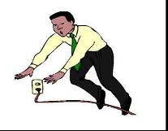
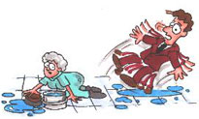
GENERAL INSTRUCTIONS FOR SAFER WORK PRACTICING AT "HOME"
Stumbling over obstacles : Be really careful for the presence of cables on the floor (eg power cables for laptops, vacuum cleaners, ballasts)
Slipping:
Clean spilled liquids (water, infusions, etc.) that cause slipping.
When moping, inform your roommates (family members) and place a mobile slippery sign or object that blocks access.

Slide 7
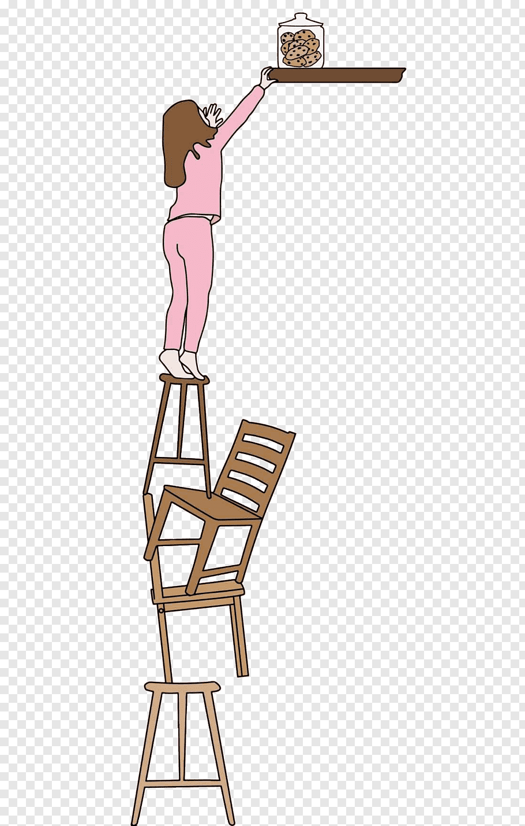
GENERAL INSTRUCTIONS FOR SAFER WORK PRACTICING AT "HOME"
Fall from stairs:
Do not climb on chairs, tables, stools, etc. or other improvised construction
Get a "L" type staircase or a three-step, CE certified
When you climb a ladder, there should be a second person, who will hold the ladder
Hit from falling objects:
Avoid placing everyday objects in high places
Take care of the stabilization of furniture equipment such as shelves, cabinets, bookshelves etc
Heavy items are stored on low shelves.

Slide 8
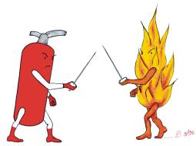
GENERAL INSTRUCTIONS FOR SAFER WORK PRACTICING AT "HOME"
Individual or Family Action Plan, as well as the supply or ensuring adequacy of firefighting equipment, is necessary to deal with an Emergency such as a fire or earthquake.
FIRE:
Know exactly where the fire extinguishers are in your house
Supply your home with adequate number of fire extinguishers
In case of fire during cooking the use of water on the utensil is PROHIBITED. Cover the pot or pan with the lid that comes with it or with a wet towel
It is PROHIBITED to throw water in a fire created by a short circuit in electrical / electronic equipment.
Transmission Paths of SARS-CoV-2

Slide 9
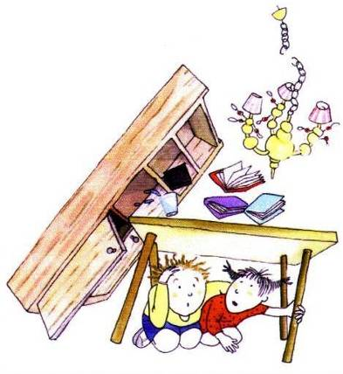
GENERAL INSTRUCTIONS FOR SAFER WORK PRACTICING AT "HOME"
EARTHQUAKE:
Create a family earthquake plan.
Locate safe places in each room (under tables, desks).
Locate dangerous places (windows, mirrors, hanging objects, fireplaces and tall furniture).
Set the emergency meeting point of your family, in case you get lost, when evacuating your home.
Choose a person (friend or relative) that your family members can call after the earthquake and notify on your situation

Slide 10
GENERAL INSTRUCTIONS FOR SAFER WORK PRACTICING AT "HOME"
Work stress: Work stress is what is created by performing a task
Create a stable personal work space (dining room, living room), which will help you get in the mood for work.
Create a work schedule and make sure it is followed
Create your personal routine, such as having a coffee alone, with a roommate or even with a remote friend using video chats.
Explain to your family that you work and that you can not be distracted from your duties to do housework
Work in remote groups, using telephones, video conferencing, or exchanging information by email.

Slide 11



GENERAL INSTRUCTIONS FOR SAFER WORK PRACTICING AT "HOME"
To deal with stress:
Apply simple relaxation techniques (breathing, relaxation, meditation, positive vision)
Get into a physical exercise program .
Follow a diet plan that includes fruits, vegetables and plenty of fluids .
Smile
Laugh
Sleep well
Small Joys. Do the simple things you enjoy (not expensive, not time consuming, that can be done immediately and quickly)

Slide 12
INSTRUCTIONS FOR SAFE USE OF COMPUTERS AT "HOME"
Working with visual data display (DSE) poses a number of risks associated with the use of the equipment, mainly musculoskeletal disorders, vision problems and mental fatigue.
Display:
Adjust the brightness and contrast of the screen
The screen should be placed in front of you (not on the side) and at a height slightly below eye level
If you use a Laptop for a long time, then it is necessary to use an external keyboard and mouse

Slide 13
GENERAL INSTRUCTIONS FOR SAFER WORK PRACTICING AT "HOME"
Office furniture/Desk:
The table or desk must be adequately dimensioned, have smooth edges and corners and allow arm and hand support.
Seat:
It must be stable, allow freedom of movement & comfortable posture.
Have a sufficient back to support its entire surface & gentle protrusion at the level of the back
Handrails for elbow rest should not obstruct access to the table.

Slide 14
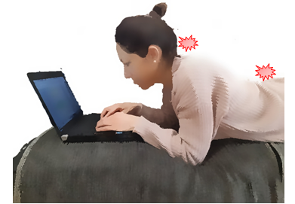
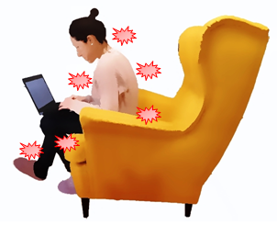
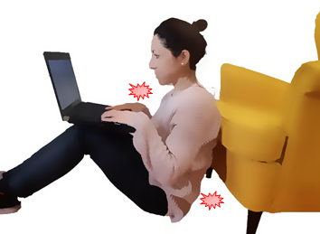
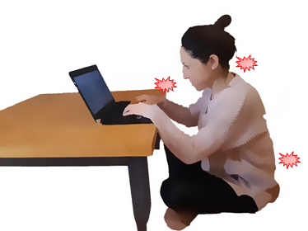
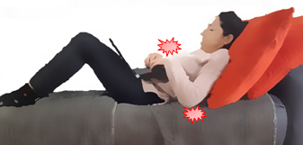
GENERAL INSTRUCTIONS FOR SAFER WORK PRACTICING AT "HOME"
Positions that should be avoided:

Slide 15
GENERAL INSTRUCTIONS FOR SAFER WORK PRACTICING AT "HOME"
Noise: can cause distraction, irritability, discomfort with possible psychosomatic charging. Noise comes from: noisy machines, from outside or be caused by the family members . For these reasons, you should:
Place noisy machines such as printers in remote parts of the house
Adjust the volume of the home telephone to its lowest level.
Set personal telephones in low volume or silent operation.
Keep the windows of your home closed to reduce outside noise.
Manage your involvement with your family members, and if possible reduce both the frequency and duration of your work breaks.
Especially for children, you can plan quiet activities or alternate supervision with your partner.

Slide 16
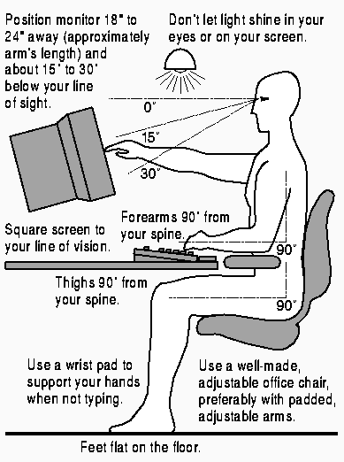
GENERAL INSTRUCTIONS FOR SAFER WORK PRACTICING AT "HOME"
Working ergonomically:

Slide 17
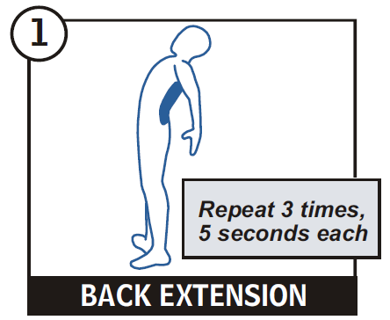
GENERAL INSTRUCTIONS FOR SAFER WORK PRACTICING AT "HOME"
Stress Relief Advice:
Stand up regularly
Take short breaks
Do stress relief
exercises
Take deep breaths

Slide 18
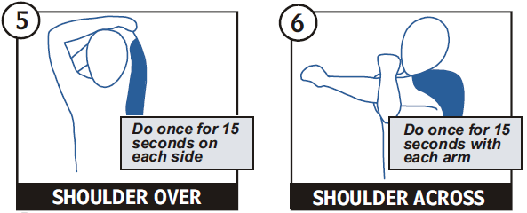
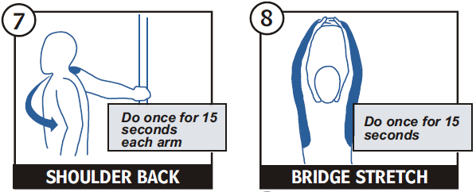
GENERAL INSTRUCTIONS FOR SAFER WORK PRACTICING AT "HOME"

Slide 19
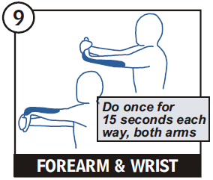
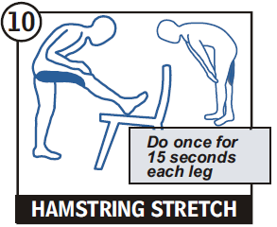
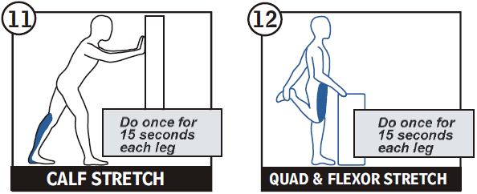
GENERAL INSTRUCTIONS FOR SAFER WORK PRACTICING AT "HOME"

